Slide 1
Flight Delay Prediction J Vinay POLANKI M00355995
CIS 663 Developing Analytical Applications

Slide 2
Outline Of Project
Motivation For Project
Data
Research Question
Challenges
Discussion and Limitations
Results
Future Work
Conclusion

Slide 3
Motivation Of the Project:
Indian Rail Tracking Application is the Idea behind the Project.
Helps Airlines to increase Operational performance.
Airlines Manages Operations and resources effectively
Passengers can manage their travel based on the flight delay.
provides better customer service and avoids Inconvenience

Slide 4
DATA:
DATA Collected from Bureau Of Transportation Statistics which provides the Historical Flight DATA.
Data is collection Historical Flight Data like Airport, Carrier, Different type of Delays and Delay in minutes, Number of Arrival Flights and different reasons like carrier delayed flights arrival delayed Flights.

Slide 5
Research Question:
Through this Project I would like address the Delay of Flights based on different reasons. Where delay is greater than 120 minutes(2 hours).
This Predictive Model helps both Airlines and Passengers to organize their journey; Airlines can effectively manage and Improve their operations
After understanding the DATA, Independent variable and multiple Dependent Variables.
I opted for Logistic Regression and Decision Tree for the prediction and to create a Model.

Slide 6
Challenges:
Understanding the DATA and Structure of it.
Finding significant variables for predicting dependent.
Data distribution in EDA analysis.
Determining and Choosing regression model for prediction.

Slide 7
Limitations Of the Project:
Excluded almost half of the rows while Filtering.
Haven’t considered other aspects or delays like ground operations.
Minimum data.
Considered DATA only for one month in a year.
More generalized as it is collected for Different Airlines and different Airports.

Slide 8
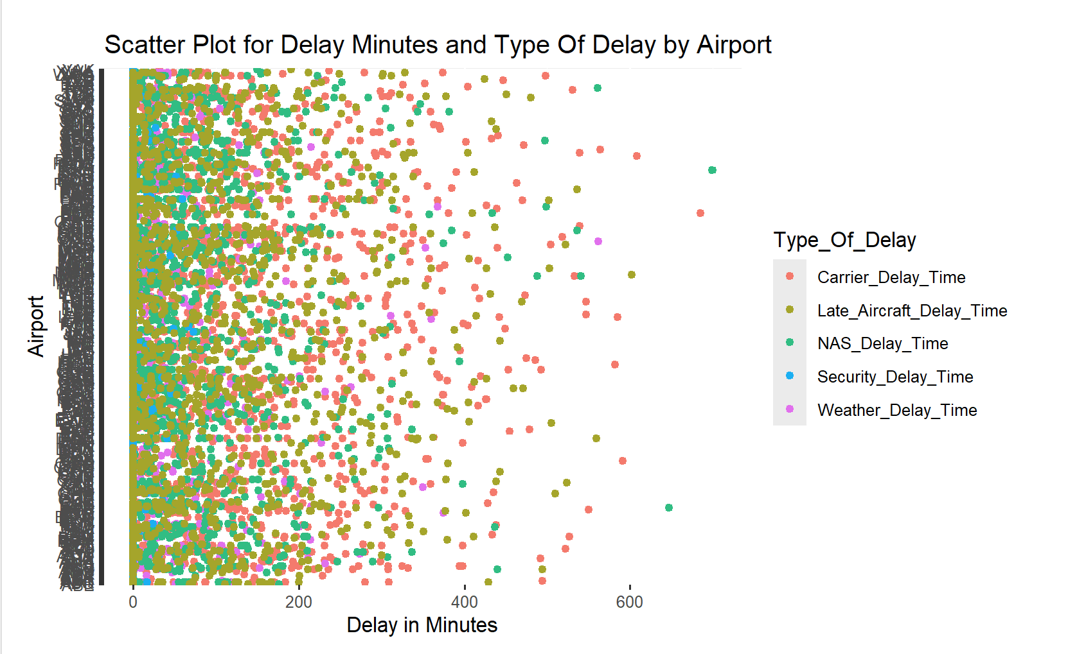
Results:
EDA Analysis:
Security Delay is Mostly Distributed close to zero.
Whereas other delays are distributed near zero with significant observations away from zero.

Slide 9
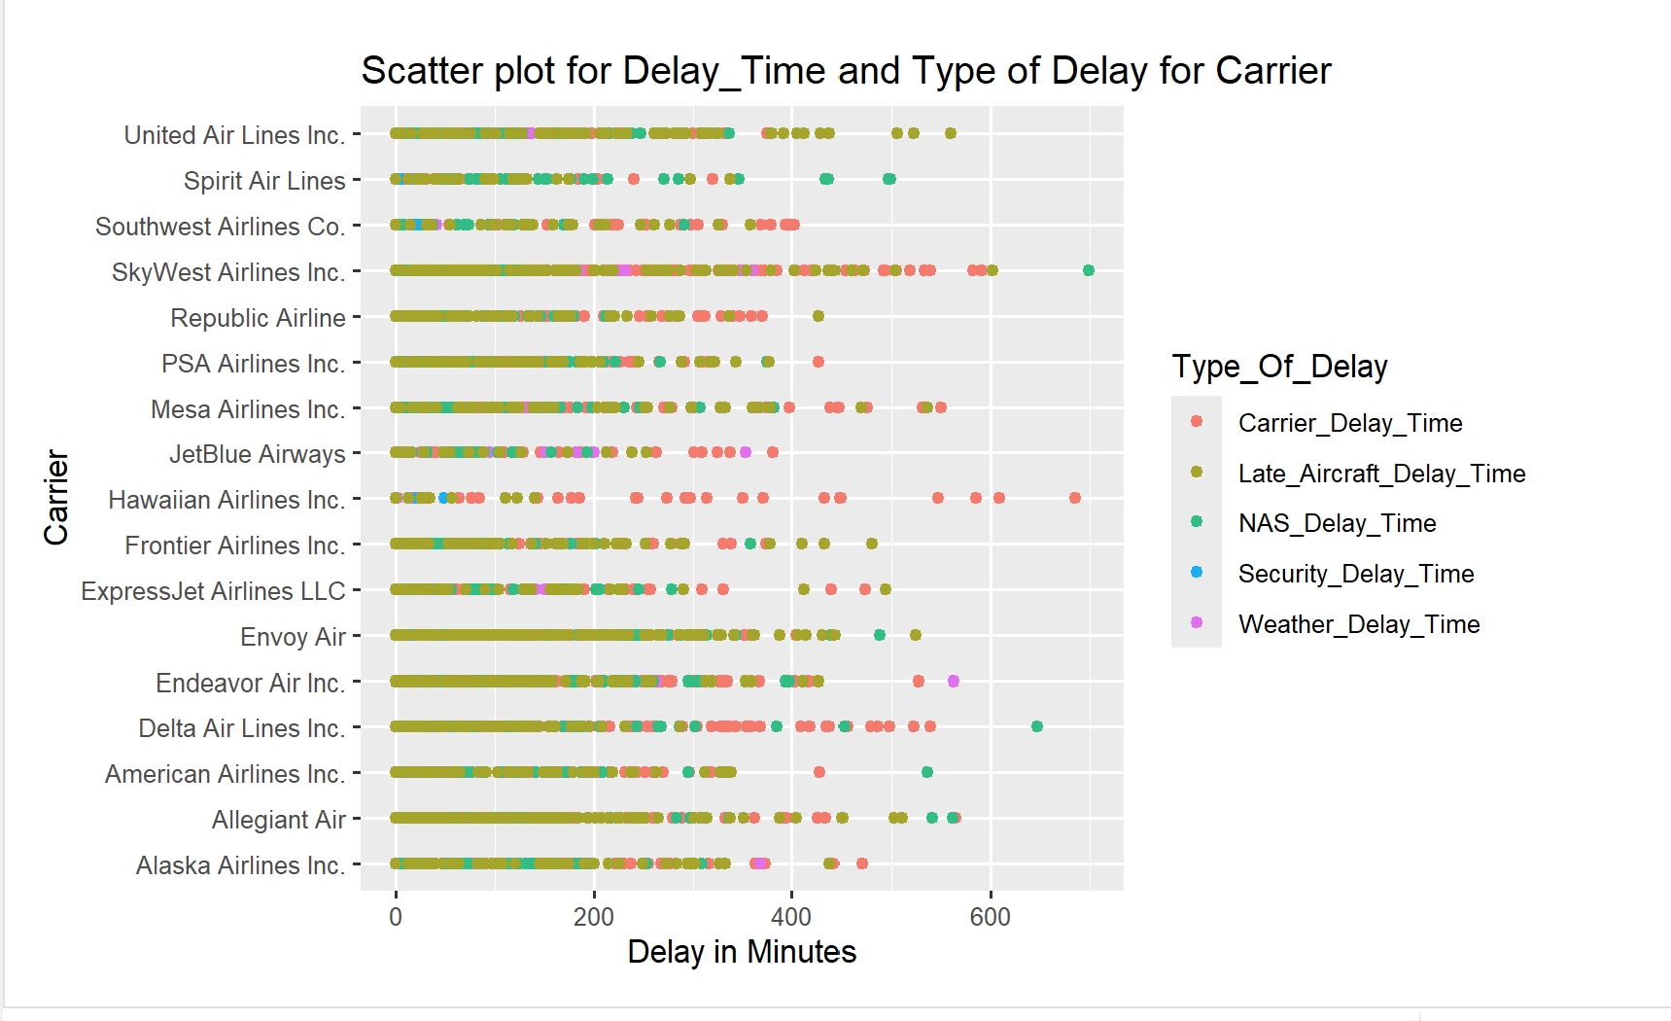
Results:

Slide 10
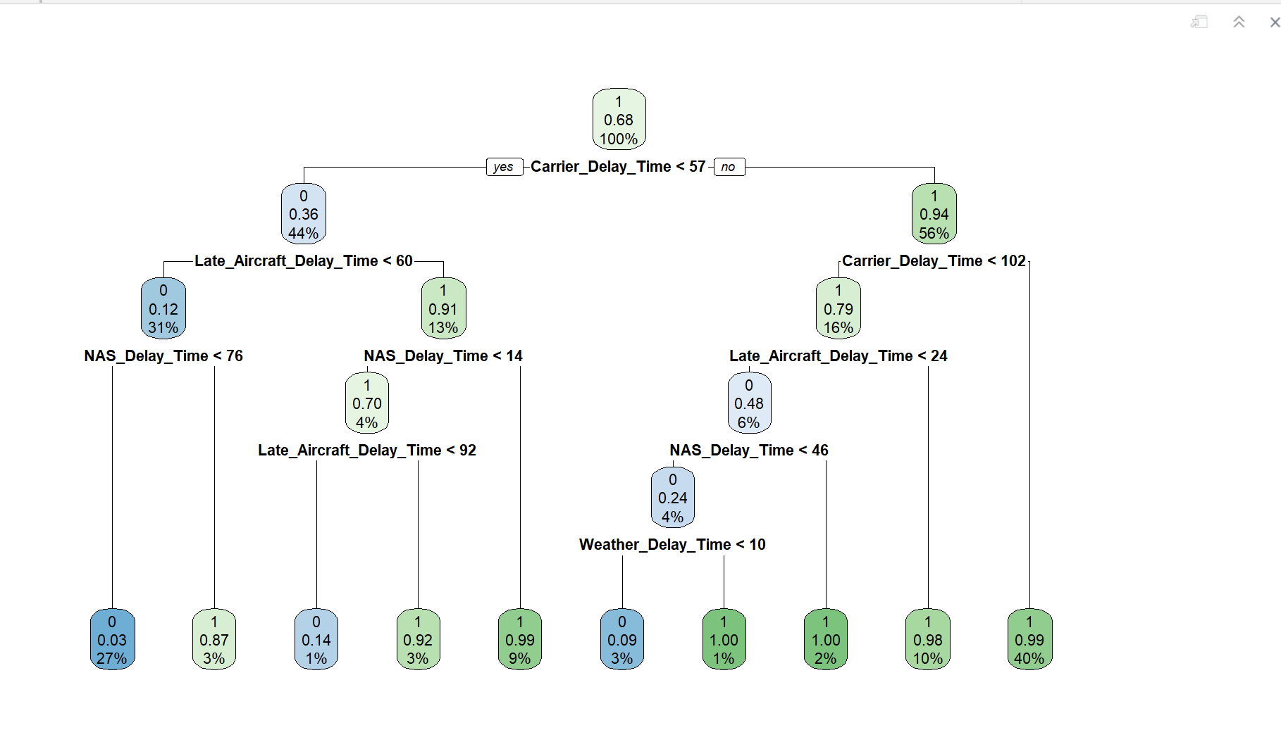
Interpretation Of Results:

Slide 11
Future_Work:
I would like to work further on this project by collecting the Data for the single airport with different carriers and considering other delays such as operational delays which include Ground operations delay, carrier check in delays.
Working on the single Airport rather than collecting a wide will allow an Airport Management to Organize and work on their operations will improve the Operational Performance of that Airport.
Same can be performed for each Carrier considering the limitations of the Airport and Federal and International Aviation Regulations. Can Perform Same with each Individual Ailines.

Slide 12

Thanks

